Slide 1
Digital Image Processing
Image Segmentation: Thresholding

Slide 2
Contents
So far we have been considering image processing techniques used to transform images for human interpretation
Today we will begin looking at automated image analysis by examining the thorny issue of image segmentation:
The segmentation problem
Finding points, lines and edges

Slide 3
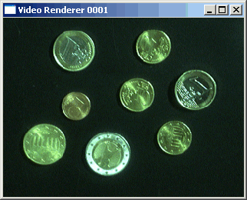
The Segmentation Problem
Segmentation attempts to partition the pixels of an image into groups that strongly correlate with the objects in an image
Typically the first step in any automated computer vision application

Slide 4
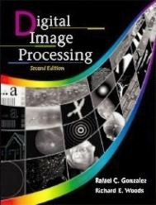
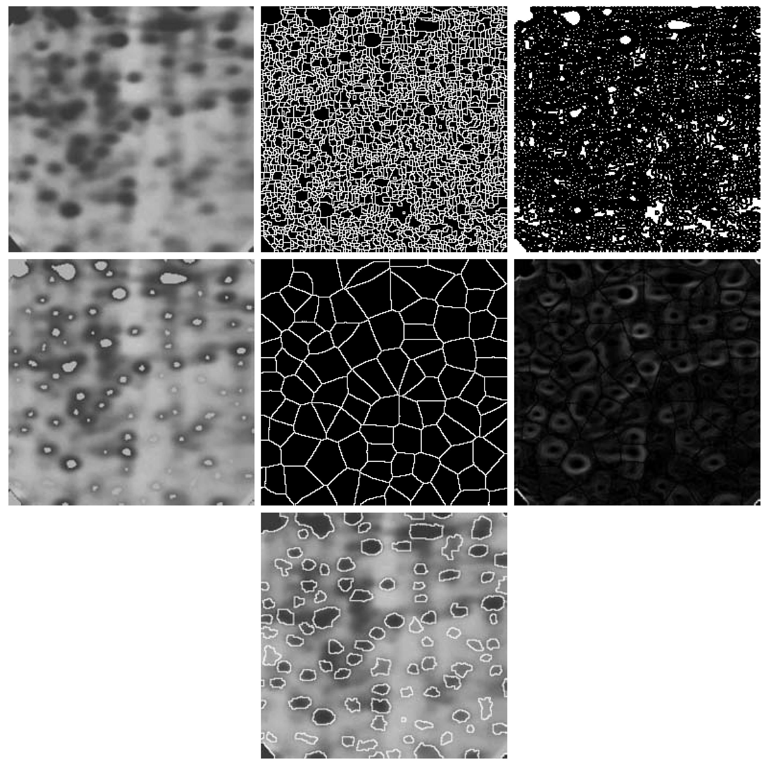
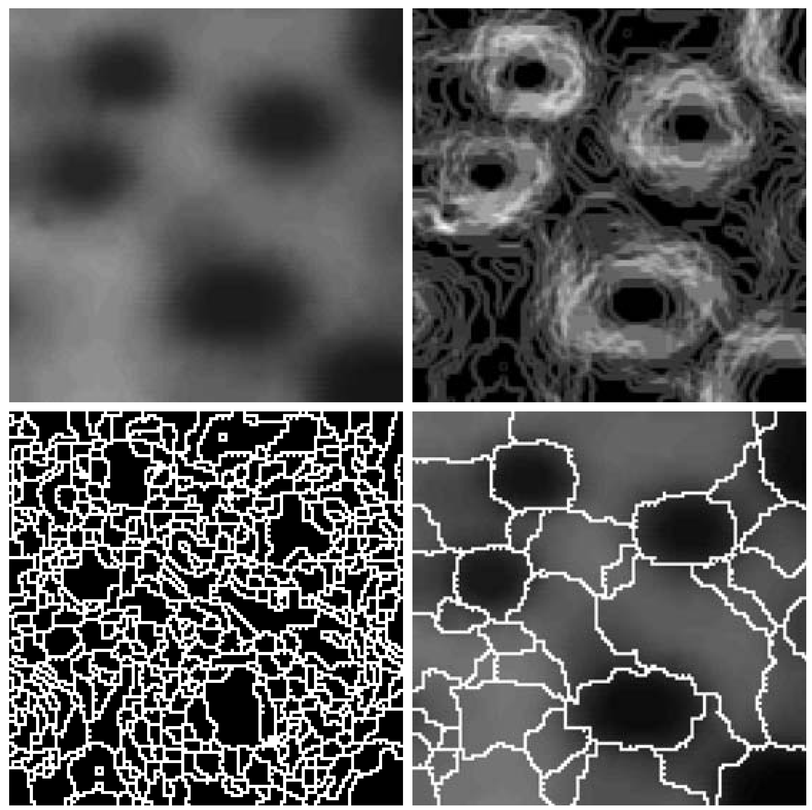
Segmentation Examples
Images taken from Gonzalez & Woods, Digital Image Processing (2002)

Slide 5
What is segmentation
Segmentation subdivides on image in to its constitute regions or objects. The level to which the subdivides is carried depends on the problem being solved .
That is segmentation should when the objects of interest in application have been isolated.

Slide 6
Detection of Discontinuities
There are three basic types of grey level discontinuities that we tend to look for in digital images:
Points
Lines
Edges
We typically find discontinuities using masks and correlation

Slide 7
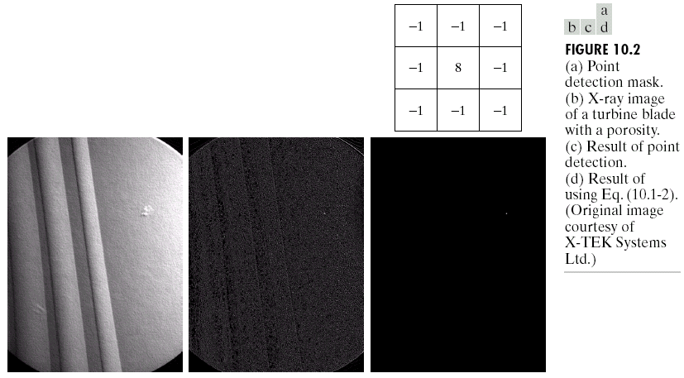
Point Detection
Point detection can be achieved simply using the mask below:
Points are detected at those pixels in the subsequent filtered image that are above a set threshold
Images taken from Gonzalez & Woods, Digital Image Processing (2002)

Slide 8
Point Detection (cont…)
Images taken from Gonzalez & Woods, Digital Image Processing (2002)
X-ray image of a turbine blade
Result of point detection
Result of thresholding

Slide 9
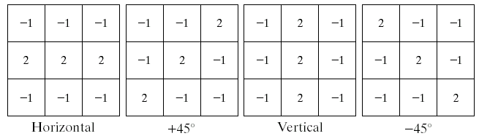
Line Detection
The next level of complexity is to try to detect lines
The masks below will extract lines that are one pixel thick and running in a particular direction
Images taken from Gonzalez & Woods, Digital Image Processing (2002)

Slide 10
What is edge?
An edge is a set of connected pixels that lie on the boundary between two regions edges are more closely modeled as having a ramp like profile.
The slope of the ramp is inversely proportional to the degree of blurring in the edge.

Slide 11
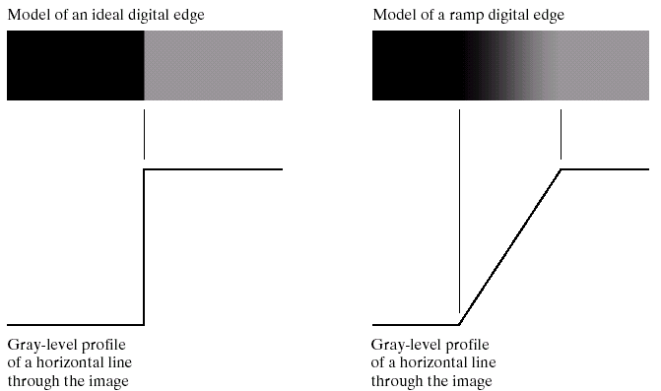
Edge Detection
An edge is a set of connected pixels that lie on the boundary between two regions
Images taken from Gonzalez & Woods, Digital Image Processing (2002)

Slide 12
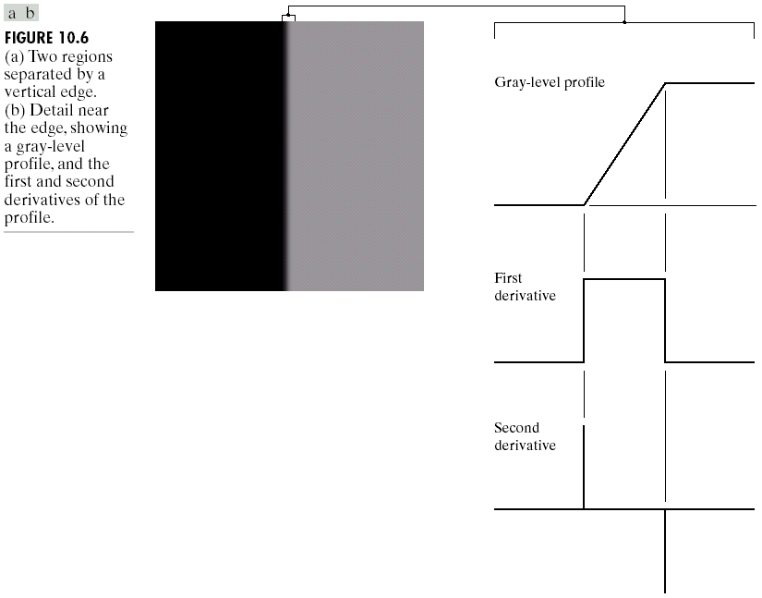
Edges & Derivatives
We have already spoken about how derivatives are used to find discontinuities
1st derivative tells us where an edge is
2nd derivative can be used to show edge direction
Images taken from Gonzalez & Woods, Digital Image Processing (2002)

Slide 13
How the derivatives are obtained in edge detection during formulation?
The first derivative at any point in an image is obtained by using the magnitude of the gradient at that point.
Similarly the second derivatives are obtained by using the laplacian.

Slide 14
Properties of the second derivative around an edge
The sign of the second derivative can be used to determine whether an edge pixel lies on the dark or light side of an edge.
It produces two values for every edge in an image.
An imaginary straight-line joining the extreme positive and negative values of the second derivative would cross zero near the midpoint of the edge.

Slide 15
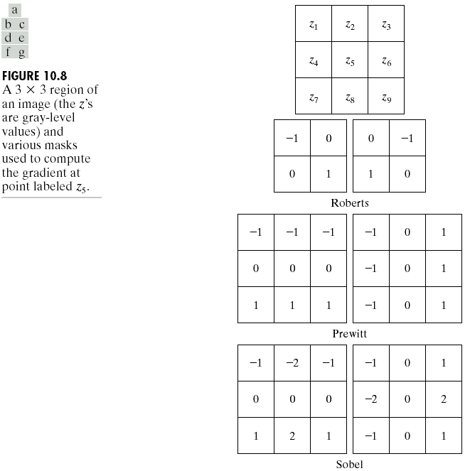
Common Edge Detectors
Given a 3*3 region of an image the following edge detection filters can be used
Images taken from Gonzalez & Woods, Digital Image Processing (2002)

Slide 16
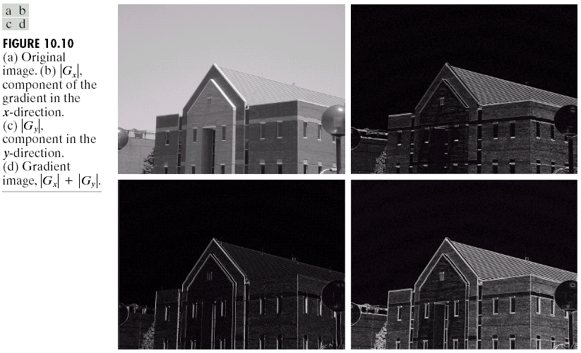
Edge Detection Example
Original Image
Horizontal Gradient Component
Images taken from Gonzalez & Woods, Digital Image Processing (2002)
Vertical Gradient Component
Combined Edge Image

Slide 17
Edge Detection Example
Images taken from Gonzalez & Woods, Digital Image Processing (2002)

Slide 18
Edge Detection Example
Images taken from Gonzalez & Woods, Digital Image Processing (2002)

Slide 19
Edge Detection Example
Images taken from Gonzalez & Woods, Digital Image Processing (2002)

Slide 20
Edge Detection Example
Images taken from Gonzalez & Woods, Digital Image Processing (2002)

Slide 21
Edge Detection Problems
Often, problems arise in edge detection in that there are is too much detail
For example, the brickwork in the previous example
One way to overcome this is to smooth images prior to edge detection

Slide 22
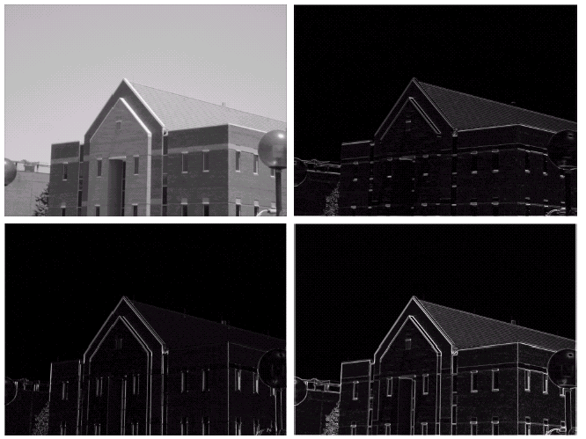
Edge Detection Example With Smoothing
Original Image
Horizontal Gradient Component
Images taken from Gonzalez & Woods, Digital Image Processing (2002)
Vertical Gradient Component
Combined Edge Image

Slide 23
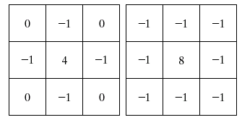
Laplacian Edge Detection
We encountered the 2nd-order derivative based Laplacian filter already
The Laplacian is typically not used by itself as it is too sensitive to noise
Usually when used for edge detection the Laplacian is combined with a smoothing Gaussian filter
Images taken from Gonzalez & Woods, Digital Image Processing (2002)

Slide 24
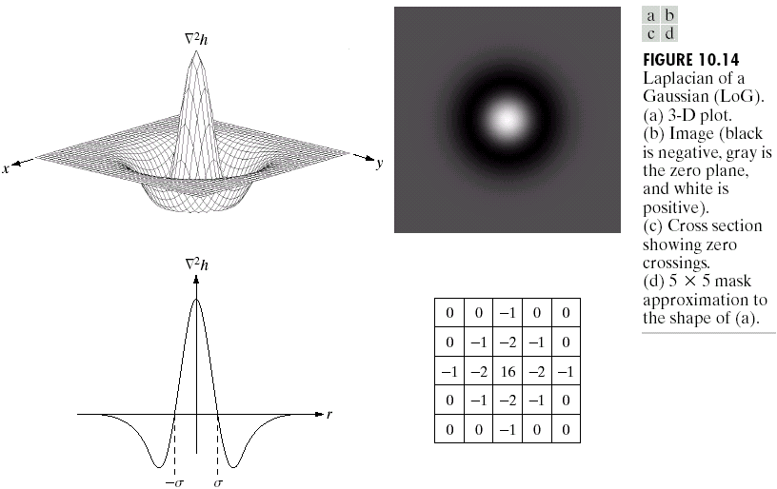
Laplacian Of Gaussian
The Laplacian of Gaussian (or Mexican hat) filter uses the Gaussian for noise removal and the Laplacian for edge detection
Images taken from Gonzalez & Woods, Digital Image Processing (2002)

Slide 25
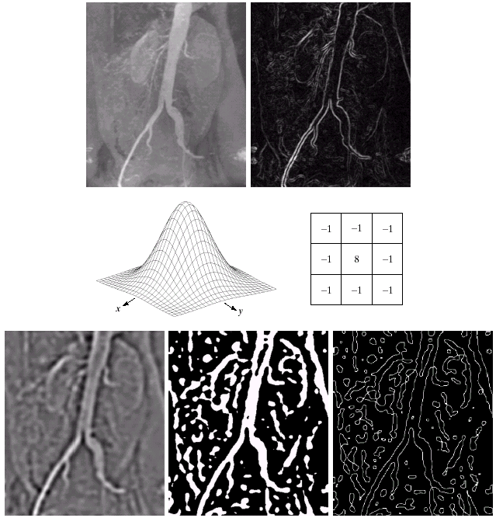
Laplacian Of Gaussian Example
Images taken from Gonzalez & Woods, Digital Image Processing (2002)

Slide 26
Global, Local and dynamic or adaptive Threshold
When Threshold T depends only on f(x,y) then the threshold is called global .
If T depends both on f(x,y) and p(x,y) is called local.
If T depends on the spatial coordinates x and y the threshold is called dynamic or adaptive where f(x,y) is the original image.

